Slide 1
Math + SRBI:
Adding It Up
Robin Moore
Math Coordinator, Regional School District 6
&
Clare Wurm, SERC Consultant

Slide 2
Schedules and Structures
SRBI are systemic
General ed teachers
Special ed teachers
Administrators
Families
Specialists, interventionists, psychologists, paraeducators, etc.

Slide 3
BASIC PRINCIPLES AND FEATURES OF SRBI:
Prevention and early intervention
High quality curriculum
Monitoring fidelity of implementation
Comprehensive assessment plan
Data-driven decision making
Notes:
Taken from the 10 basic principles and key features
Lots of overlap—systems approach so all are intertwined

Slide 4
Focus on prevention and early intervention
Applicable at all ages
Requires timely assessment and flexible intervention scheduling
High-quality Tier I instruction
Notes:
Not just pre-school students.

Slide 5
High quality curriculum and instruction
Connecticut Core Standards
Cohesive district-wide curriculum
Evaluations of curriculum and instruction

Slide 6
Monitor fidelity of implementation
Both classroom and intervention
Evaluators need to know what to look for
Peer observations

Slide 7
Comprehensive assessment plan
Universal Common Assessments
Administered periodically (3x per year)
Given to all
Predict success on standardized tests

Slide 8
Comprehensive assessment plan
Progress Monitoring
Reliable & valid,
Easy to administer
All tiers
Tier I: Common Formative Assessments throughout course
Tier II: more frequent – weekly or biweekly
Tier III: most frequent – twice per week

Slide 9
Common Math Assessments
Assessment | Company | Grades
aimsweb | Pearson | K-12
MAP | NWEA | K-12
STAR Math | Renaissance Learning | 1-12
PLUS Teacher-created assessments

Slide 10
Data-driven decision making
Teams
Grade-level/content
School-wide
District-wide

Slide 11
Data-driven decision making
Different types of data are needed to make informed decision
One data point should not dictate action—need triangulated data
Data includes information beyond test scores– teachers, counselors, paraprofessionals, administrators, parents, and students can all provide useful data

Slide 12
Data-driven decision making
Collecting the data is not enough. Data must be analyzed, interpreted, and acted upon.
Flowchart for Tiered Support & Intervention
https://mtss.madison.k12.wi.us/files/mtss/Intervention%20Tier%20Flowchart%20%281%29.pdf
Elementary Math Flowchart
https://tnlweb.madison.k12.wi.us/files/tnl/Literacy%20and%20Math%20Flowcharts%20K-12%20Final_Aug_2014%20(4).pdf
Notes:
*Will add examples of intervention flow charts/Team forms/checklists

Slide 13
SRBI & Math in action
Robin Moore
Math Coordinator, Regional School District 6

Slide 14
A Mathematical Journey through our SRBI Process
Regional School District #6
Warren, Morris, Goshen
Robin Moore
K-6 Math Coordinator, RSD#6
Rmoore@rsd6.org
Twitter: @rmoore628

Slide 15
Initiating the SRBI Process
“My student is
struggling.”
Begin pre-referral process.
-Meet with math specialist for strategies that can be implemented in classroom .
-Document strategies and progress for 6-8 weeks.
Strategies are working.
-Continue.
-No referral to SIT needed at this time.
Strategies are not working.
-Recommend to SIT.
?
?
?
?
?
?
Notes:
Explain SIT acronym

Slide 16
Screening Tools
All Students
Universal Screening:
STAR Math Assessment
Students of Concern
Early Numeracy Interview (ENI)
Students of Concern
First Steps Diagnostic Tasks

Slide 17
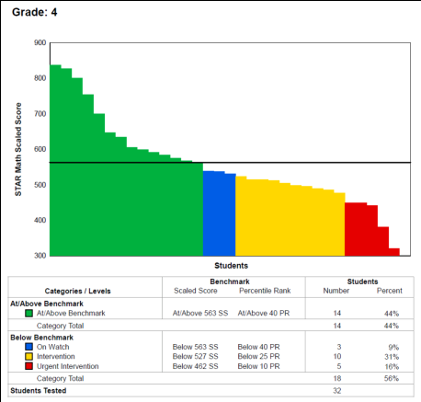
Universal Screening-STAR Math Assessment
Administered 3x per year throughout 2012-2015
In 2015-2016, will be administered 5x per year
Data analyzed to determine not only who is not meeting benchmark but who is not making adequate growth
Sample screening report for STAR Math Assessment

Slide 18
Early Numeracy Interview (ENI)
Consists of hands-on assessment tasks where students demonstrate mathematical understanding and preferred strategies for increasingly complex tasks
Used to focus on four areas: Counting, Place Value, Addition/Subtraction, Multiplication/Division
Assesses Pre-K through Grade 4 concepts
Administered by math specialists and special education teachers
Early Numeracy On-line Interview
Available at:
https://www.eduweb.vic.gov.au/edulibrary/public/teachlearn/student/mathscontinuum/onlineinterviewbklet.pdf

Slide 19
First Steps Diagnostic Tasks
Quick tasks to assess students understanding of concepts used determine an entry point along a mathematical progression
Allow one to diagnosis, plan, implement and judge the effectiveness of learning experiences provided for students
Administered by classroom teachers, special education teachers, and math specialists
Retrieved from:
http://det.wa.edu.au/stepsresources/detcms/navigation/first-steps-mathematics/
http://www.dragonflyecs.com/store/p2/Revealing_What_Students_Think%3A_Diagnostic_Tasks_for_Fractions.html

Slide 20
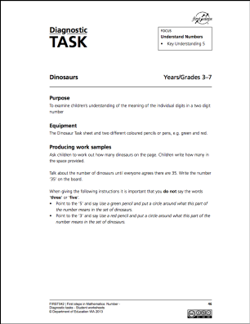
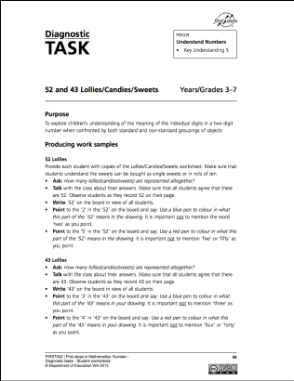
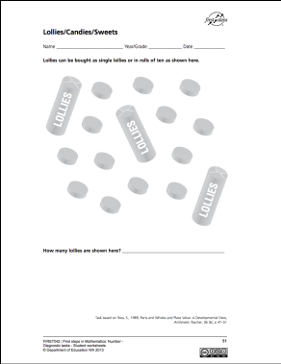
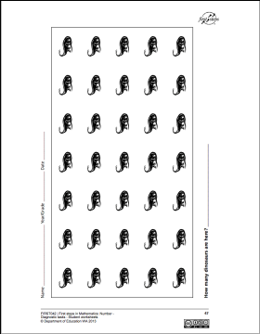
Let’s Try A First Steps Task

Slide 21
Initiating the SRBI Process
“My student is struggling.”
Begin pre-referral process.
-Meet with math specialist for strategies that can implemented in classroom .
-Document strategies and progress for 6-8 weeks.
Strategies are working.
-Continue.
-No referral to SIT needed at this time.
Strategies are not working.
-Recommend to SIT.

Slide 22
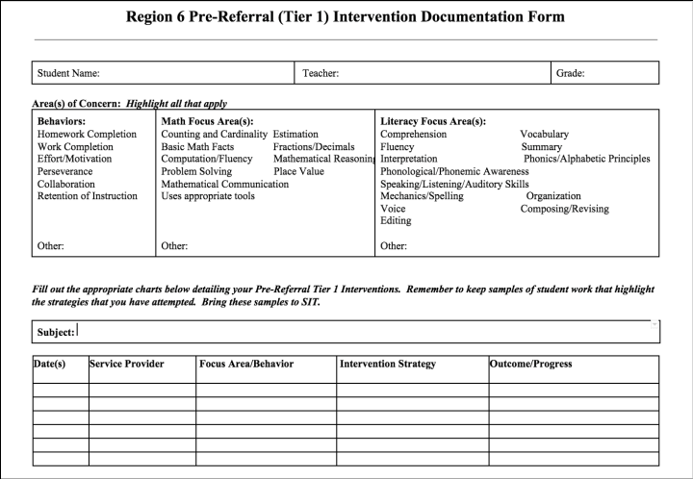
Pre-referral Form

Slide 23
Student Intervention Team (SIT) Cycle
Determine SMART Goal(s)
Determine Plan
Implement Plan
Document Progress
Analyze and Reflect on Progress
6-8 Weeks

Slide 24
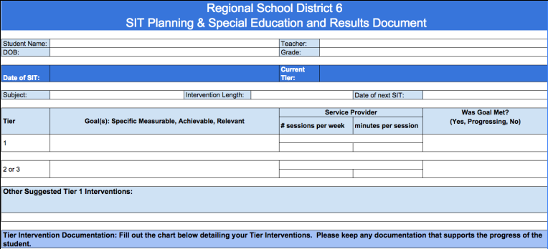
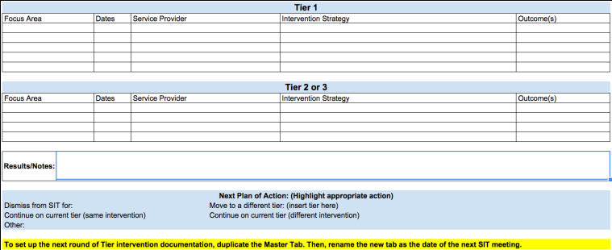

Slide 25
SIT Meetings
Who is present?
Classroom teachers of students presented
Math/literacy specialist
Frequency?
SIT Meetings are built into morning schedule every Wednesday before students come; additional meetings added if needed
Efficiency?
Agenda for each meeting
Other relevant support staff (ie. Social worker)
Special Education Teacher
Principal
Every student in tier 1, 2, 3 as well as those identified as ELL and Special Education is discussed on a rotating basis; minimum of 6-8 weeks
All documentation is done through forms on Google Docs
Roles of participants in meeting established
Protocols and expectations in place such as coming prepared
Administrator enforces accountability

Slide 26
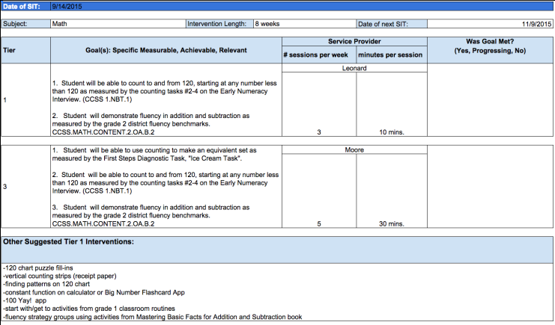
Sample Student SIT Document
Tier 1 and 2 Goals and Plan

Slide 27
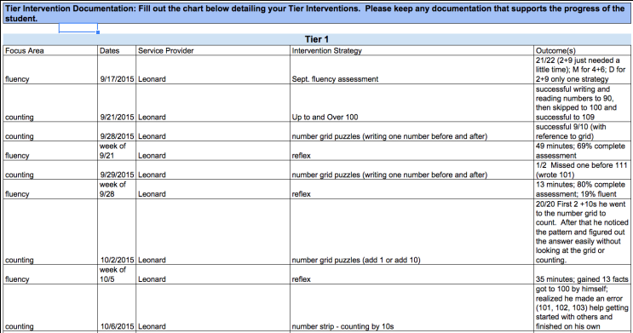
Sample Student SIT Document Cont.
Tier 1 Documentation to Support Work toward Goals

Slide 28
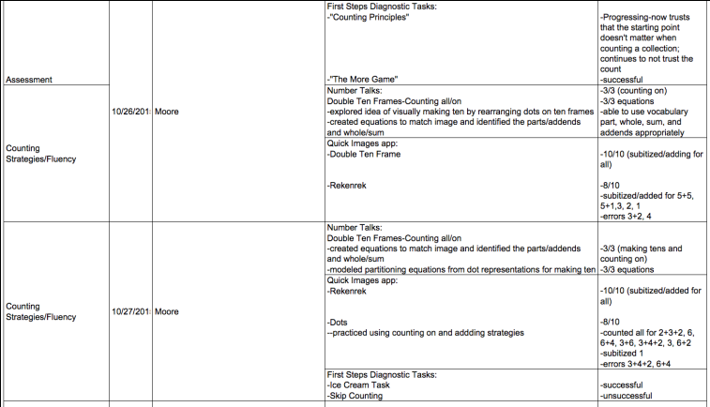
Sample Student SIT Document Cont.
Tier 2 Documentation to Support Work toward Goals

Slide 29
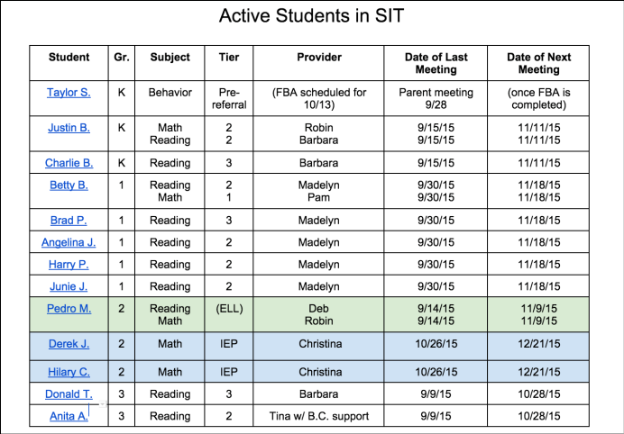
Meeting everyone’s Needs
Our Active SIT List keeps us on track with the ongoing process.

Slide 30
QUESTIONS?

Slide 31
Resources
CCS Math “Look Fors” Flipbook –guide for core math instruction http://www.sde.ct.gov/sde/lib/sde/pdf/backtoschool/ccss_principal_look_fors_flipbook.pdf
Center on Response to Intervention at American Institutes for Research http://www.rti4success.org/
Intervention Central –tools & resources
http://www.interventioncentral.org/home
The What Works Clearinghouse: Instructional methods and materials http://www.ies.ed.gov/ncee/wwc

Slide 32
Contact us or visit the SERC Library
Clare Wurm, Consultant, SERC
tel: 860-632-1485, x 383
email: wurm@ctserc.org
SERC LIBRARY offers more than 10,000 resources: www.ctserc.org/library
Books
Instructional materials
Tests
Journals
Online databases
DVDs, videos, CD-ROMs
Professional development materials for staff
Notes:
Thank you for spending the day with us.
Please remember to fill out an evaluation, your input strengthens our offerings.
Please feel free to contact us or to visit our Library if you need further resources.

