Slide 1
Universal Design for Learning (UDL) in Planning and Implementing Interventions
EQUITY. EXCELLENCE. EDUCATION.

Slide 2
Presenters
Sean Kavanaugh- Consultant, SERC
Glenn McGrath- Director of Pupil Services, WHPS
Lynnette Kaschke- Assistive Technology Specialist
Aimee Heaton- Teacher, Norfeldt Elementary School
Wanda Hedman- Teacher, Norfeldt Elementary School
Eva Golden- Teacher, Sedgwick Middle School
Liz Natale- Teacher, Sedgwick Middle School

Slide 3
Universal Design for Learning
A scientifically valid framework that
provides multiple means of engagement, access, assessment, and removes barriers in instruction
to achieve academic and behavioral success
for all

Slide 4
UDL at a Glance

Slide 5
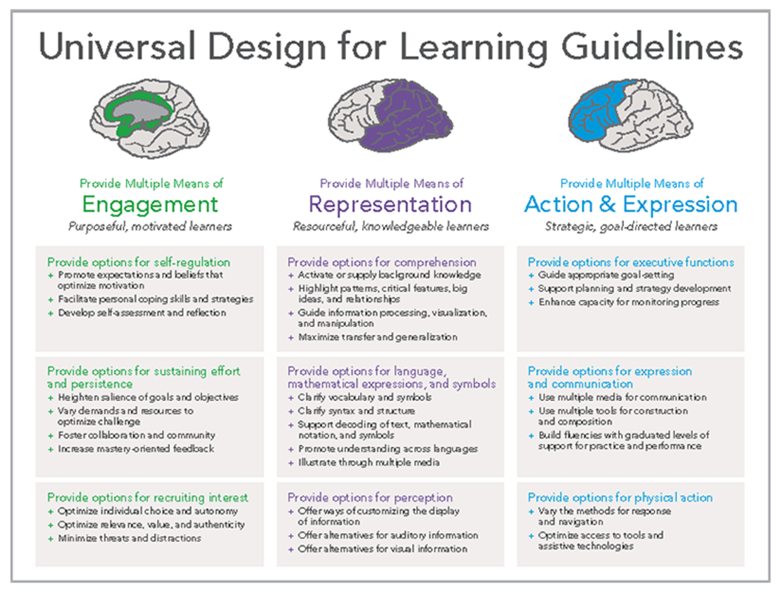
UDL Principles, Policy and Practices A Brief Review
http://www.udlcenter.org/aboutudl/take_a_tour_udl

Slide 6
4 Components of UDL
Goals
Materials
Methods
Assessments

Slide 7
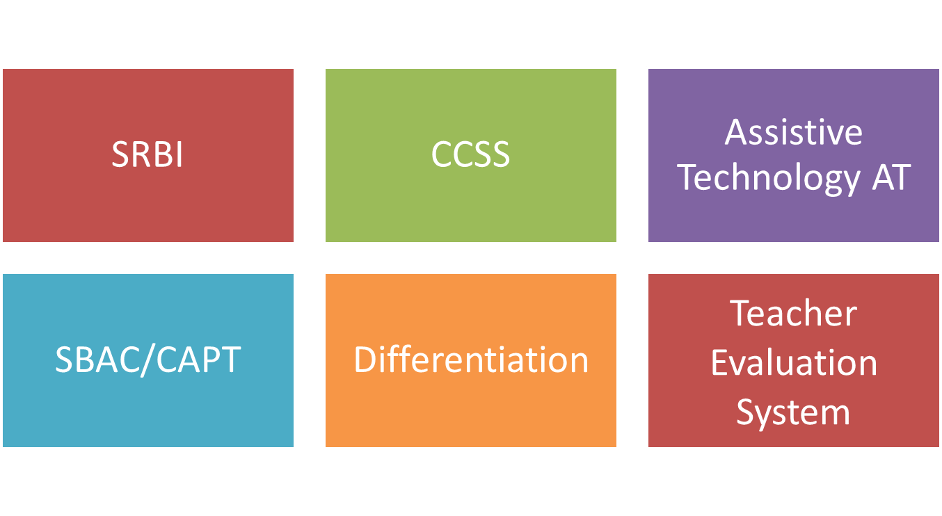
The “Intersection of Instruction”
Universal Design for Learning
Assessment

Slide 8
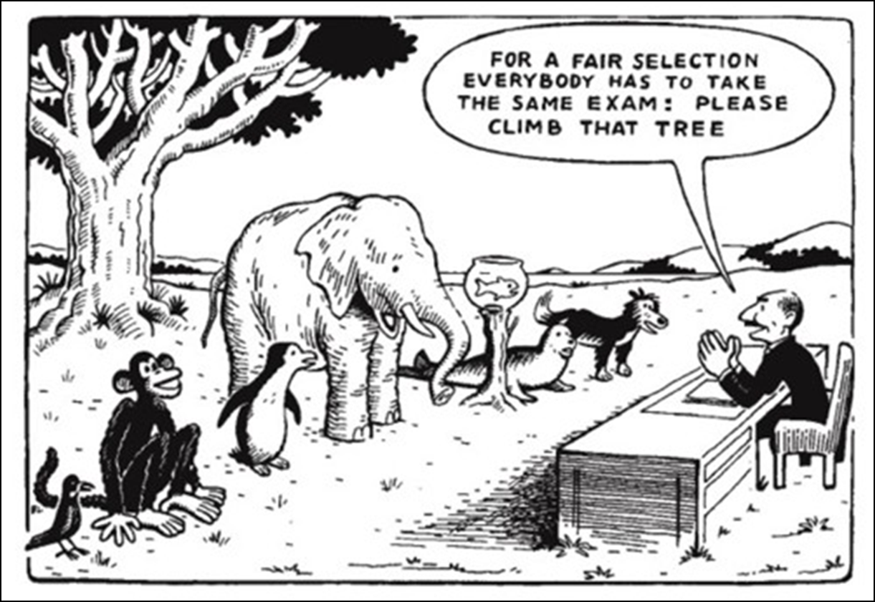
Barriers in the Curriculum
Aimee Heaton and Wanda Hedman 2014

Slide 9
The Implementation of UDL

Slide 10
UDL Planning and Development
UDL Cohort Meetings
Professional Development
District UDL Academy Website
https://sites.google.com/a/whps.org/udl/
UDL School-Based Action Plans
5. UDL Districtwide Symposium October, 2014
6. “Meeting the Challenge” sessions
Over the past 3 years we have been significantly involved in the planning and development of UDL. Because of our efforts, West Hartford is recognized as an exemplar by CREC and throughout the state as taking a leadership role in the implementation of UDL.

Slide 11
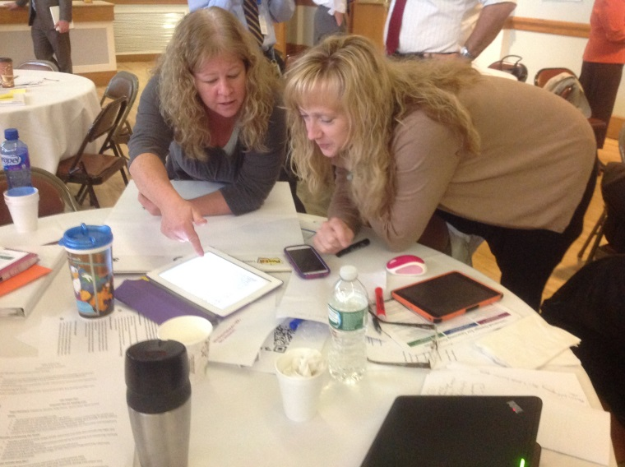
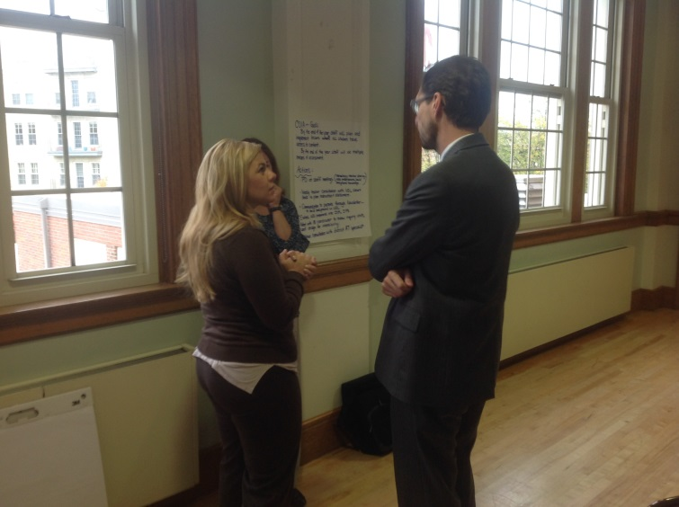
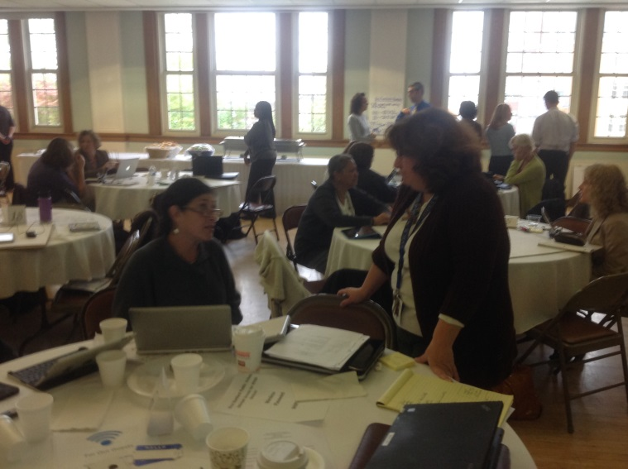
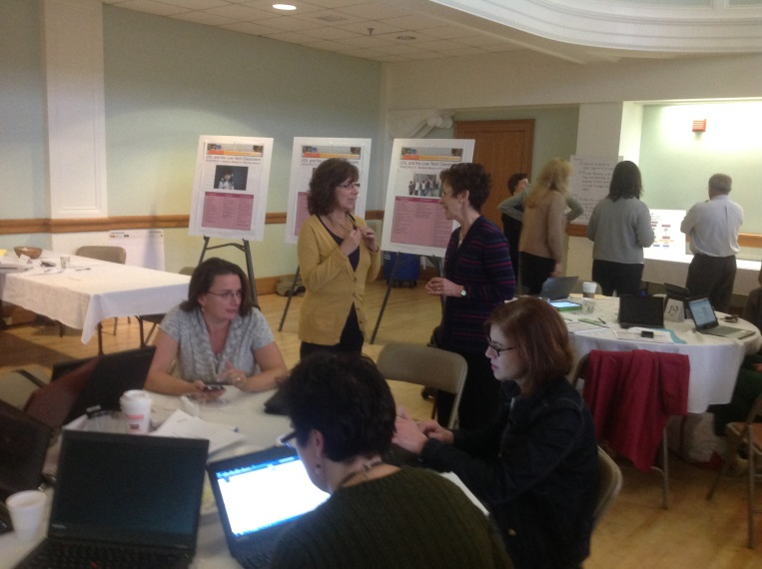
Collaboration

Slide 12
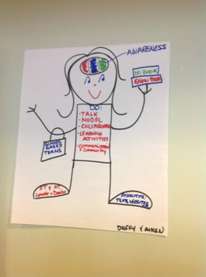
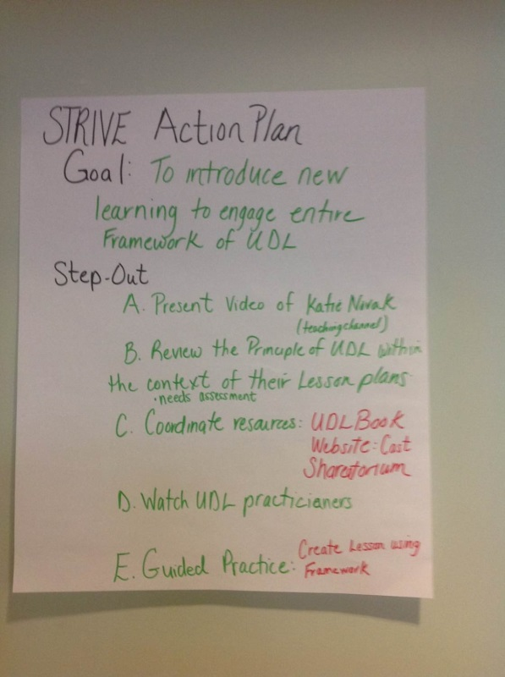
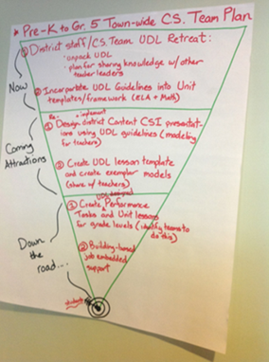
School-Based
UDL Planning

Slide 13
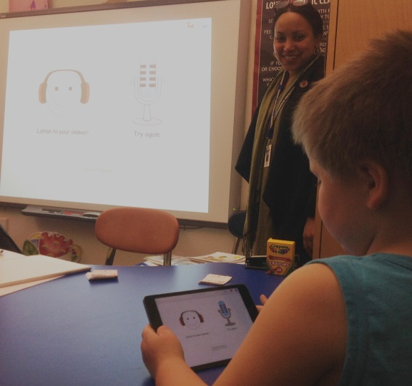
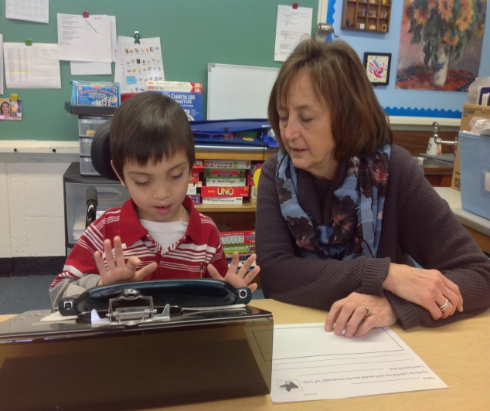
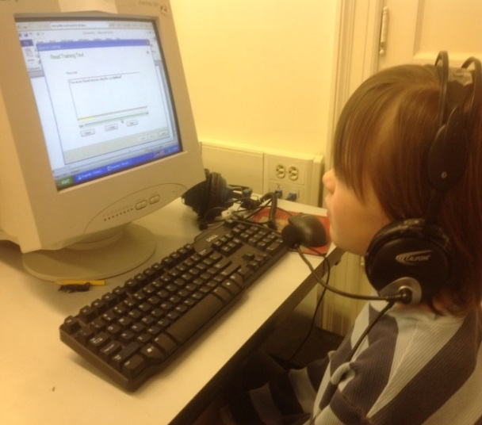
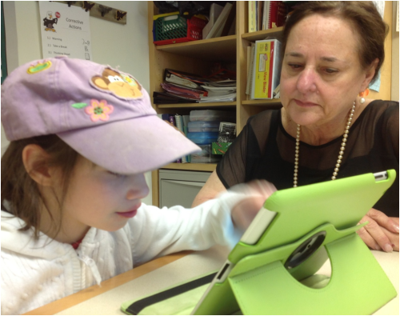
UDL and Assistive Technology

Slide 14
Implementing UDL and AT
Working toward the goal of AT available throughout the district to support facilitation of UDL
General and special educators along with computer and technology specialists (and others as needed) are included in making the technology decisions
Purchase software that provides many options (e.g., text-to-speech, word prediction, student assessment and tracking)
Download, use trial versions and explore use of technologies to assist in decision considerations
Whenever possible, use printed instructional materials that also have digitized options (AIM)
Provide students options for authoring/presenting written assignments utilizing software/devices. (UDL)

Slide 15
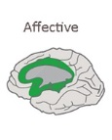
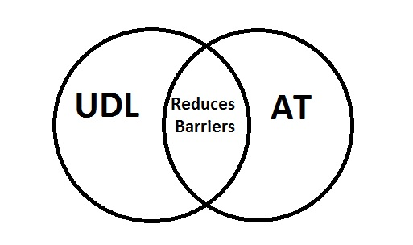

Slide 16
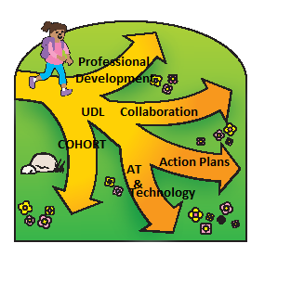
Moving Forward
Continued professional development and supporting teachers with UDL resources
Schools continue to review, assess and expand their School-Based Action Plans
Continued expansion of the UDL Cohort
Continued collaboration with other districts
Continued access to Assistive and Instructional technologies

Slide 18
Resources
UDL Center
http://www.udlcenter.org/implementation/examples
UDL at a Glance
www.youtube.com/watch?v=bDvKnY0g6e4‎
CAST (Center for Applied Special Technology)
www.cast.org
http://castprofessionallearning.org/free-udl-webinars/
A Story of Robotics and Autism
www.youtube.com/watch?v=nwJsxLOilcc‎
UDL and Assistive Technology- Two Sides of the Same Coin
http://craigcunningham.com/nlu/tie536fall09/Assistive%20Technology%20and%20UDL_TwoSidesoftheCoin.pdf
UDL Academy Website
https://sites.google.com/a/whps.org/udl/

Slide 19
Questions

Slide 20
Contact Information
Sean Kavanaugh, Consultant,
SERC
kavanaugh@ctserc.org
Glenn McGrath, Director of Pupil Services
West Hartford Public Schools
glenn_mcgrath@whps.org
SERC LIBRARY, Offers more than 10,000 resources , www.ctserc.org/library
Books
Instructional materials
Tests
Journals
Online databases
DVDs, videos, CD-ROMs
Professional development materials

Slide 21
Rolling Out UDL
Create and implement our school-based action plan
Introduce the UDL philosophy to the staff
Model the principles, processes and practices
Determine what aspects of UDL are already taking place in the classroom

Slide 22
Perseverance
An Assignment Using Universal Design for Learning
by Eva Golden and Liz Natale
This unit was presented to the entire faculty to exemplify UDL principles and practice.
This is an abbreviated and condensed version of the presentation.
Sedgwick Middle School

Slide 23
The unit was designed by 6th-grade English teachers during curriculum planning last summer.
The teachers who planned the unit provided short story titles, poems, speeches, videos to set the stage for reading a novel focusing on perseverance.
All 6th grade students participated in the unit.
The Perseverance Unit

Slide 24
UDL Principles
Three primary principles of UDL
WHAT

Slide 25
UDL Principles
Three primary principles of UDL
WHAT
HOW

Slide 26
UDL Principles
Three primary principles of UDL
WHAT
HOW
WHY

Slide 27
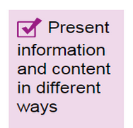
The Assignment
Multiple Means of Representation
The Teacher Presentation
Activate multiple senses to receive, recognize and store information in student working memories
Builds in motivation based on learner interest areas and needs by providing choice of participation medium
Recognizes student individual learning styles.

Slide 28
Types of Teacher Presentations
Low tech
Novels, letters, poems, etc.
Demonstration
Advance organizers
Models
Posters

Slide 29
Types of Teacher Presentations
Low tech
Novels, letters, poems, etc.
Demonstration
Advance organizers
Models
Posters
High tech
Videos (speeches, movies, etc.)
YouTube
Miscellaneous education sites (BrainPop, Khan Academy, etc.)
PowerPoint/ Prezi presentations
Smartboard
Audiobooks

Slide 30
Reflections On Perseverance
“Mother to Son" by Langston Hughes
Well, son, I’ll tell you:
Life for me ain’t been no crystal stair.
It’s had tacks in it,
And splinters,
And boards torn up,
And places with no carpet on the floor—
Bare.
But all the time
I’se been a-climbin’ on,
And reachin’ landin’s,
And turnin’ corners,
And sometimes goin’ in the dark
Where there ain’t been no light.
So boy, don’t you turn back.
Don’t you set down on the steps
’Cause you finds it’s kinder hard.
Don’t you fall now—
For I’se still goin’, honey,
I’se still climbin’,
And life for me ain’t been no crystal stair.
Angela Duckworth TED Talk: Grit
Miley Cyrus Sings “The Climb”

Slide 31
Steve Jobs Commencement Speech
Show a video of the Steve Jobs Stanford University commencement address and provide students with the text.
Have students write a response to the open-ended question “What do you think is the most important lesson people can learn from Steve Jobs?”

Slide 32
Student Survey Results
Which presentation allowed you to understand what “perseverance” means?
Steve Jobs video/transcript 40%
The Climb song 33%
“Grit” video 20%
Langston Hughes Poem 07%

Slide 33
The Assignment
Students had to demonstrate their understanding of Perseverance after viewing all three reflections.

Slide 34
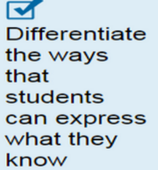
Multiple Means of Expression
Student Response
Provide options for how students to express what they have learned.
Build in motivation based on learner interest areas and needs by providing choice of participation mediums.
Create a piece of art: draw, paint, make a collage, etc.
Write a poem, rap, essay, personal narrative, etc.
Make a video, Google Presentation, Prezi, Glogster, Wordle
Create a poster
Draw a cartoon strip
Compile a collection of quotes about perseverance
Do your own thing (speak with Mrs. Golden or Ms. Natale before you start)

Slide 35
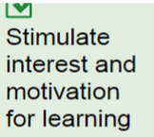
Multiple Means of Engagement
Student Participation
Recruits student interest
Sustaining effort and persistence
Self-Regulation
Real world authentic tasks
Flexibility in use of tools to access information

Slide 36
The Assignment
Students had to demonstrate their understanding of Perseverance after viewing all three reflections. Their understanding could take any expressive form they would like, as long as it was clear.
Low tech
Written expression (poems, essays, etc.)
Journal entries
Demonstrations
Debates
Models
Posters
Drawings
etc.
High tech
Videos
PowerPoint/Prezi presentations
Glogster
Powtoons
Multi-media productions
WebQuests
Wordle
etc.

Slide 37
Student Work
How they demonstrated their understanding of Perseverance

Slide 38
Student Work
LOW
TECH

Slide 39
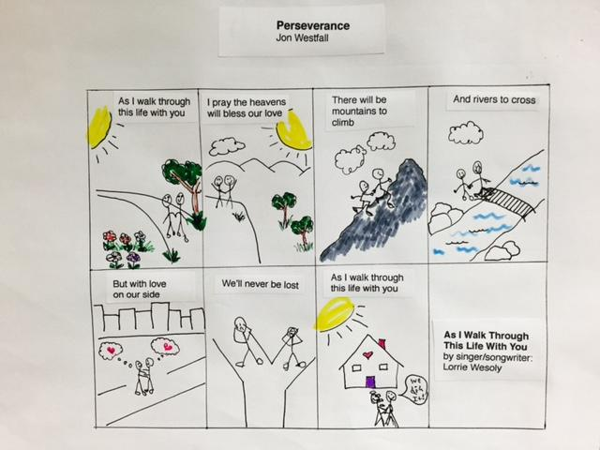
Comic

Slide 40
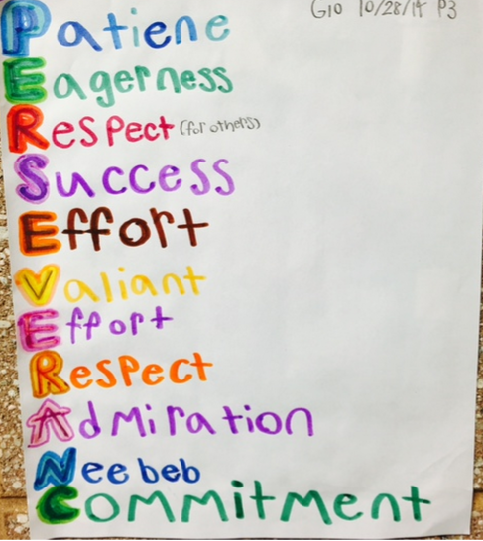
Poster

Slide 41
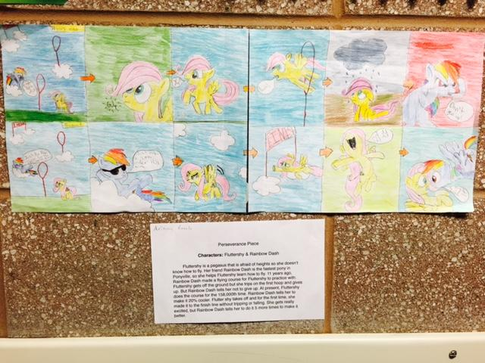
Story Board

Slide 42
Written Assignment
Mason’s poem (Grade 6)
Perseverance
Perseverance is everything.
Courage, determination, and braveness.
Perseverance is everything.
Not stopping, always climbing to the top.
Perseverance is everything.
Not letting anything get in your way.
Perseverance is everything.
Overcoming obstacles that challenge you.
Perseverance is everything.
Simply put, it is the greatest force of human strength.

Slide 43
Student Work
HIGH
TECH

Slide 44
Google Presentation
Poster:
“Continuous effort is the key to unlocking your potential.

Slide 45
PowToon

Slide 46
Prezi

Slide 47
Halle’s Video

